Slide 1

School of Coumputing Science and Engineering
Course Code: BCS01T1003 Course Name: Programming for Problem Solving – C
UNIT 4
Structure
Introduction and Declaration
Faculty Name: Prof. (Dr.) Sansar Singh Chauhan Program Name: B. Tech. AI & DS

Slide 2
Outline
Structure:
Introduction,
Declaration
Initialization
Accessing Structure Member
Program Name: B. Tech. AI & DS

Slide 3
Structure: Introduction and application
A collection of one or more variables, typically of different types, grouped together under a single name for convenient handling
Known as struct in C
Structures may contain variables of many different data types—in contrast to arrays that contain only elements of the same data type.
Structures are commonly used to define records to be stored in files .
Pointers and structures facilitate the formation of more complex data structures such as linked lists, queues, stacks and trees .
Program Name: B. Tech. AI & DS

Slide 4
Structure: Definition
Structures are derived data types—they are constructed using objects of other types.
Consider the following structure definition:
struct card { char *face; char *suit; };
Keyword struct introduces the structure definition.
The identifier card is the structure tag, which names
the structure definition and is used with the keyword
struct to declare variables of the structure type.
Program Name: B. Tech. AI & DS

Slide 5
Structure: Definition
In this example, the structure type is struct card.
Variables declared within the braces of the structure definition are the structure’s members.
Members of the same structure type must have unique names, but two different structure types may contain members of the same name without conflict (we’ll soon see why).
Each structure definition must end with a semicolon.
struct card { char *face; char *suit; };
Program Name: B. Tech. AI & DS

Slide 6
Structure: Definition
The definition of struct card contains members face and suit of type char *.
Structure members can be variables of the primitive data types (e.g., int, float, etc.), or aggregates, such as arrays and other structures.
Structure members can be of many types.
Program Name: B. Tech. AI & DS

Slide 7
Structure: Definition
For example, the following struct contains character array members for an employee’s first and last names, an int member for the employee’s age, a char member that would contain 'M' or 'F' for the employee’s gender and a double member for the employee’s hourly salary:,
struct employee { char firstName[ 20 ]; char lastName[ 20 ]; int age; char gender; double hourlySalary; };
Program Name: B. Tech. AI & DS

Slide 8
Structure: Definition
A structure cannot contain an instance of itself.
For example, a variable of type struct employee cannot be declared in the definition for struct employee.
A pointer to struct employee, however, may be included.
For example,
struct employee2 { char firstName[ 20 ]; char lastName[ 20 ]; int age; char gender; double hourlySalary; struct employee2 person; /* ERROR */ struct employee2 *ePtr; /* pointer */ };
struct employee2 contains an instance of itself (person), which is an error.
Program Name: B. Tech. AI & DS

Slide 9
Structure: Definition
Because ePtr is a pointer (to type struct employee2), it is permitted in the definition.
A structure containing a member that is a pointer to the same structure type is referred to as a self-referential structure.
Self-referential structures are used to build linked data structures.
Program Name: B. Tech. AI & DS

Slide 10
Structure: Definition
Structure definitions do not reserve any space in memory; rather, each definition creates a new data type that is used to define variables.
Structure variables are defined like variables of other types.
The definition
struct card aCard, deck[ 52 ], *cardPtr;
declares aCard to be a variable of type struct card, declares deck to be an array with 52 elements of type struct card and declares cardPtr to be a pointer to struct card.
Program Name: B. Tech. AI & DS

Slide 11
Structure: Definition
Variables of a given structure type may also be declared by placing a comma-separated list of the variable names between the closing brace of the structure definition and the semicolon that ends the structure definition.
For example, the preceding definition could have been incorporated into the struct card structure definition as follows:
struct card { char *face; char *suit; } aCard, deck[ 52 ], *cardPtr;
Program Name: B. Tech. AI & DS

Slide 12
Structure: Definition
The structure tag name is optional.
If a structure definition does not contain a structure tag name, variables of the structure type may be declared only in the structure definition—not in a separate declaration.
Program Name: B. Tech. AI & DS

Slide 13
Structure: Definition
The only valid operations that may be performed on structures are:
assigning structure variables to structure variables of the same type,
taking the address (&) of a structure variable,
accessing the members of a structure variable, and
using the sizeof operator to determine the size of a structure variable.
Program Name: B. Tech. AI & DS

Slide 14
Structure: Definition
Structures may not be compared using operators == and !=, because structure members are not necessarily stored in consecutive bytes of memory.
Sometimes there are “holes” in a structure, because computers may store specific data types only on certain memory boundaries such as half word, word or double word boundaries.
Program Name: B. Tech. AI & DS

Slide 15
Structure: Point to remember
Structure Definition
struct employee2 { char firstName[ 20 ]; char lastName[ 20 ]; int age; char gender; double hourlySalary; };
Structure Declaration
struct card aCard, deck[ 52 ], *cardPtr;
Program Name: B. Tech. AI & DS

Slide 16
Structure: Initialization
Structures can be initialized using initializer lists as with arrays.
To initialize a structure, follow the variable name in the definition with an equals sign and a brace-enclosed, comma-separated list of initializers.
For example, the declaration
struct card aCard = { "Three", "Hearts" };
creates variable aCard to be of type struct card and initializes member face to "Three" and member suit to "Hearts".
struct card { char *face; char *suit; }
Program Name: B. Tech. AI & DS

Slide 17
Structure: Initialization
If there are fewer initializers in the list than members in the structure, the remaining members are automatically initialized to 0 (or NULL if the member is a pointer).
Structure variables defined outside a function definition (i.e., externally) are initialized to 0 or NULL if they are not explicitly initialized in the external definition.
Structure variables may also be initialized in assignment statements by assigning a structure variable of the same type, or by assigning values to the individual members of the structure.
Program Name: B. Tech. AI & DS

Slide 18
Structure: Accessing Structure Members
Two operators are used to access members of structures: the structure member operator (.)—also called the dot operator—and the structure pointer operator (->)—also called the arrow operator.
The structure member operator accesses a structure member via the structure variable name.
For example, to print member suit of structure variable aCard use the statement
printf( "%s", aCard.suit ); /* displays Hearts */
struct card { char *face; char *suit; }
Program Name: B. Tech. AI & DS

Slide 19
Structure: Accessing Structure Members
The structure pointer operator—consisting of a minus (-) sign and a greater than (>) sign with no intervening spaces—accesses a structure member via a pointer to the structure.
Assume that the pointer cardPtr has been declared to point to struct card and that the address of structure aCard has been assigned to cardPtr.
To print member suit of structure aCard with pointer cardPtr, use the statement
printf( "%s", cardPtr->suit ); /* displays Hearts */
Program Name: B. Tech. AI & DS

Slide 20
Structure: Accessing Structure Members
The expression cardPtr->suit is equivalent to (*cardPtr).suit, which dereferences the pointer and accesses the member suit using the structure member operator.
The parentheses are needed here because the structure member operator (.) has a higher precedence than the pointer dereferencing operator (*).
The structure pointer operator and structure member operator, along with parentheses (for calling functions) and brackets ([]) used for array subscripting, have the highest operator precedence and associate from left to right.
Program Name: B. Tech. AI & DS

Slide 21
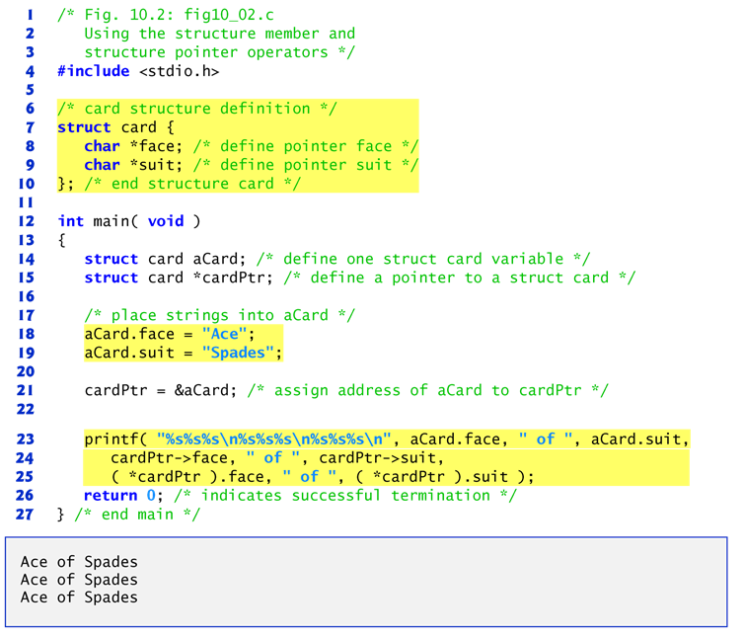
Program
Program Name: B. Tech. AI & DS

Slide 22
Contact Information
Email-ID
sansar.chauhan@galgotiasuniversity.edu.in
Program Name: B. Tech. AI & DS

Slide 23

Prerequisite
Can we allocate only arrays?
malloc can be used to allocate memory for single variables also
p = (int *) malloc (sizeof(int));
Allocates space for a single int, which can be accessed as *p
Single variable allocations are just special case of array allocations
Array with only one element
Program Name: B. Tech. AI & DS

